Slide 1
PokéBattle in Sweden
By: Oreen Yousuf & Jae Eun Hong

Slide 2

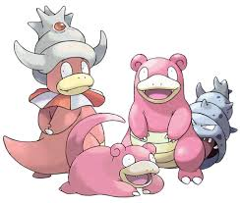
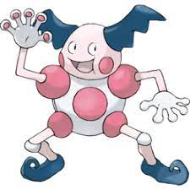
What does it do?
Simulate a Pokémon battle from the games
Allows user to choose:
Difficulty level
Pokémon of choice
Pikachu / slowpoke / mister mime
Location / region
Uppsala / GÖteborg / Stockholm
Commands of battle
Attack / defend

Slide 3
Technicalities
React
Heroku
GitHub
CSS
Rasa/NLU

Slide 4
Challenges
Count variables in conditional statements targeting specific states
Creation of multiple cond statements in lieu of functional embedded || and && operators
Voice recognition for grammar variables
Multiple takes for demo

Slide 5
Relation
Lab 2 and 4 provided the backbone to do this project
Learning the logic behind finite state machines
Structure of grammar-based coding
Flow of functions were necessary to progress any amount and debug along the way

Slide 6
Future work
Maybe include features from Lab 3 to overcome voice recognition and pronunciation from App (Amazon Polly features)
Multiplayer
Double the grammars to allow multiple players (n=2-4) to choose from their own list of Pokemon.
Creation of n-1 additional states and store decisions in memory
Additional state would then determine the status of the player under attack from the previous player’s attack/defend option.
Move beyond Attack and Defend
Introduce damage -> specific command/move containing set integer variable

